Slide 1
Why DevOps?
DevOps enables
DevOps enables software development to address customer needs faster, increase speed to market, throughput, and improve operational agility.
Speed: Ability to release features to market faster.
Throughput: Increase throughput.
Quality: Higher-quality software and applications
Operational Agility: Quickly pivot to address changing customer demands
Innovation: Ability to rapidly test and learn with faster feedback loops
Continuous deployment: Leveraging self-service, automation tools
Rapid iterations on solutions and frequent feedback (test and learn) to deliver products weekly (or even daily)
Infrastructure Elasticity: Quickly deploy infrastructure scale up to meet demand, and scale down when no longer needed
Collaboration: Between Development and Operations to achieve common goals
Embracing DevOps enable orgnizations bring new solutions to market faster

Slide 2
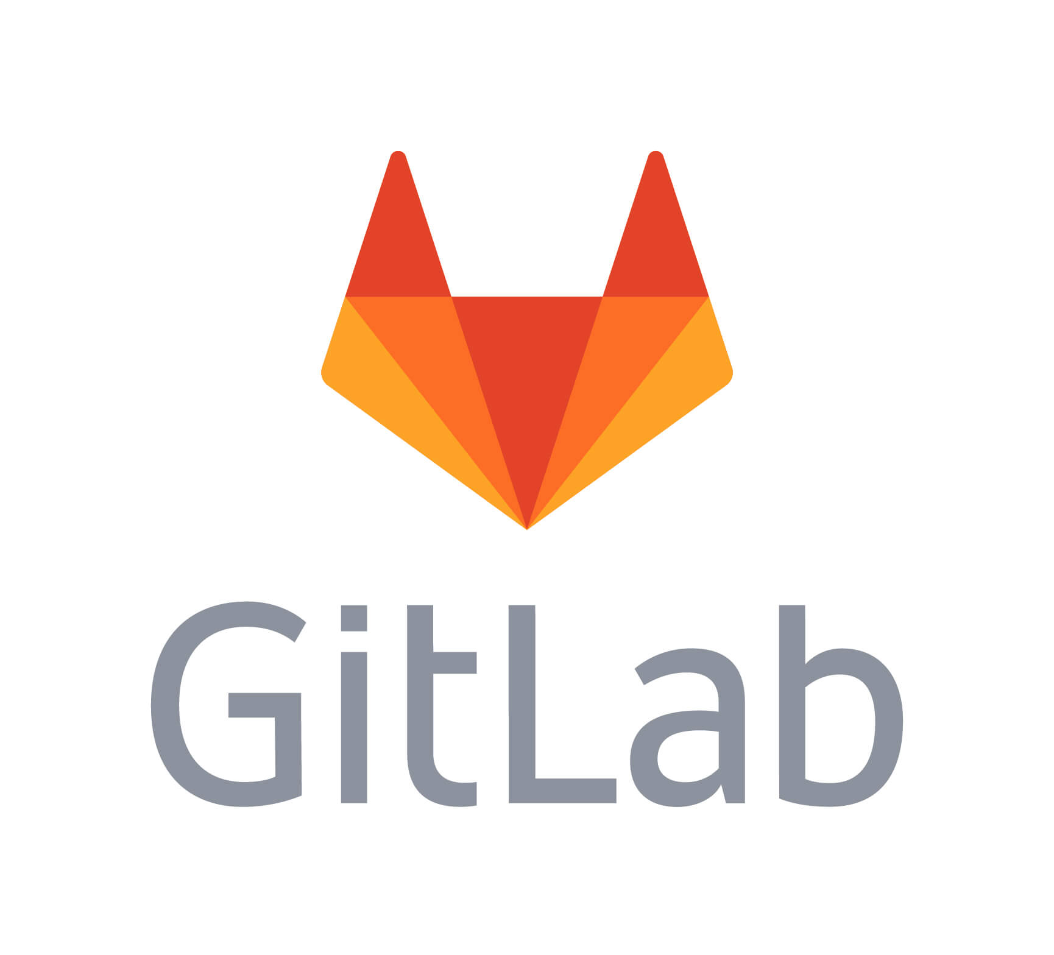
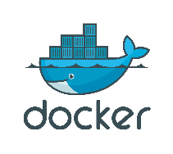
Software Delivery Tooling
Requirements
Development
Quality
Conversational
Knowledge Work
PRODUCT DELIVERY
Quality
Source Code
Management
Unit Testing
Regression
Continuous Integration
Infrastructure build configuration orchestration
Continuous Delivery
To environments
Vulnerabilities
Product Demo
Software Delivery
Defects and
Enhancements

